Slide 1
Love and Meaning Sam Shpall The University of Sydney

Slide 2
Overview of today’s themes
(1) Love in common sense, art, and philosophy
(2) Two methods
(3) Love’s psychological role
(4) Hard questions about love and agency
(5) Love pills and the normativity of love

Slide 3
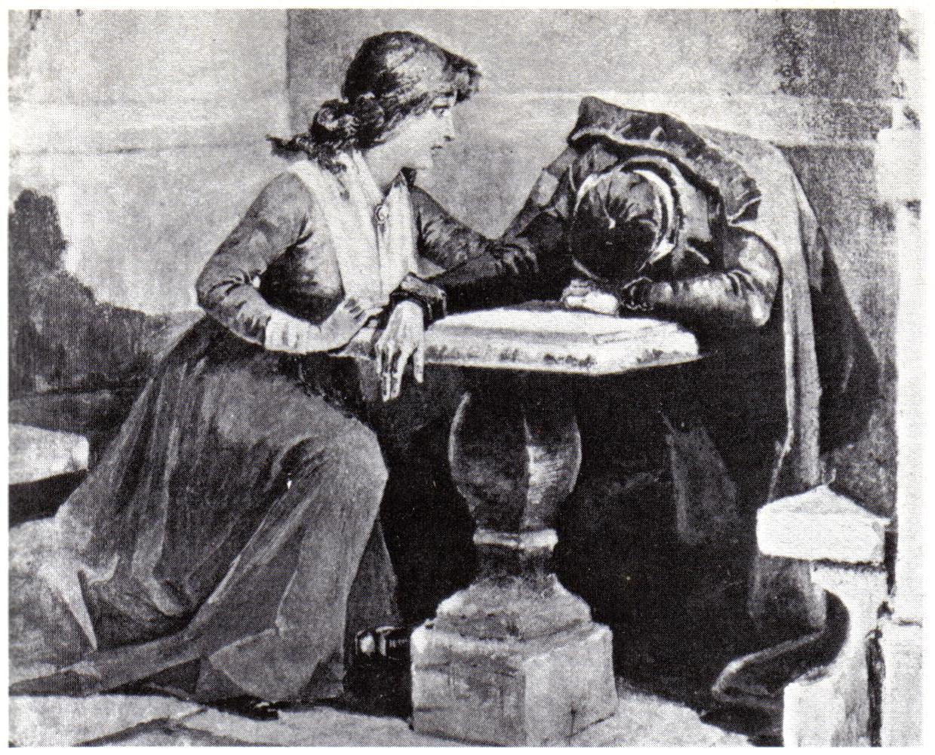
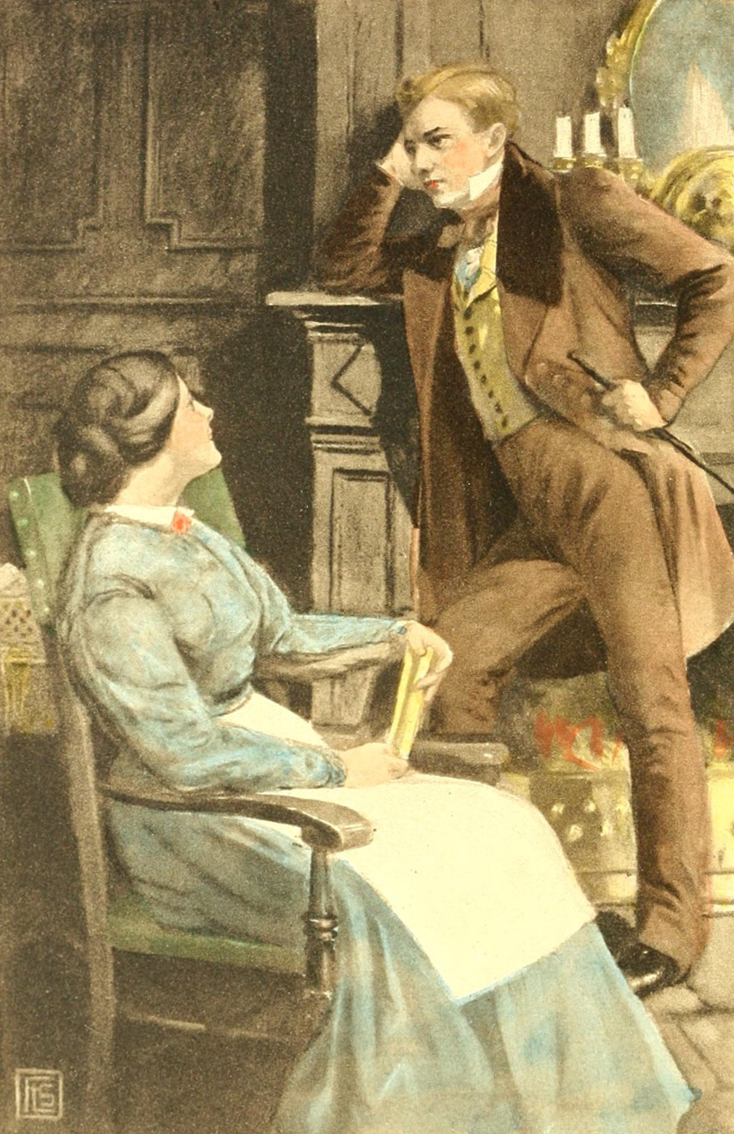

Slide 4
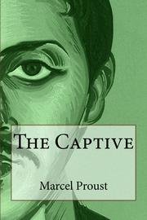
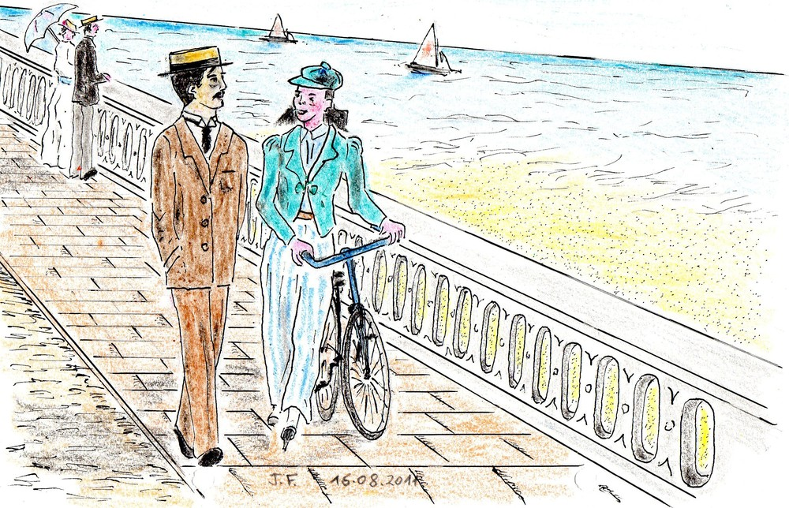

Slide 5
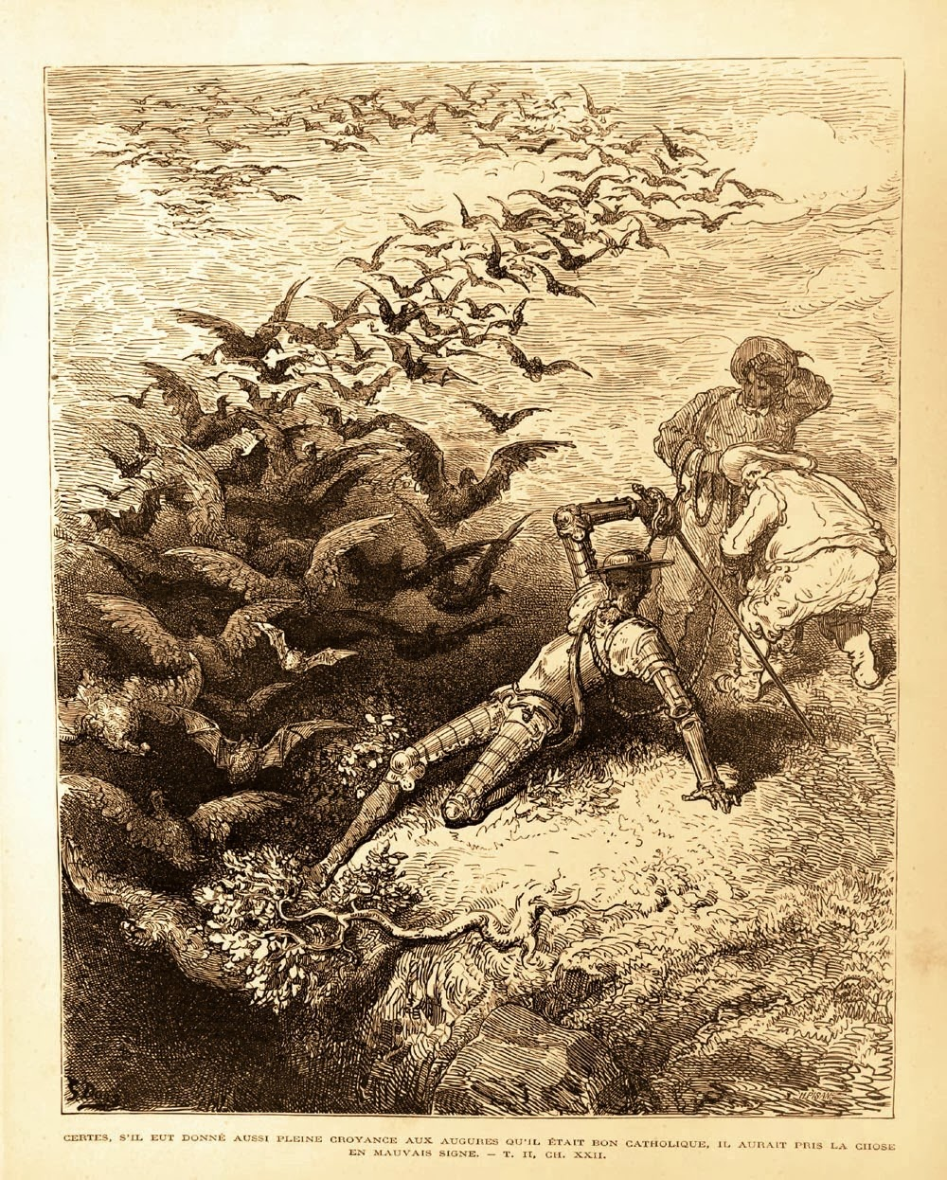

Slide 6
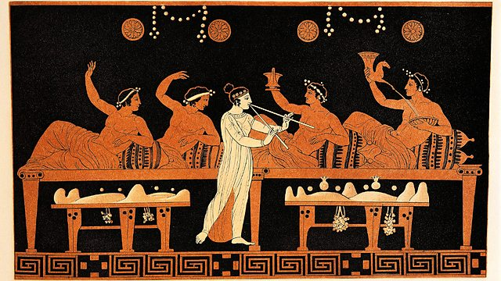

Slide 7
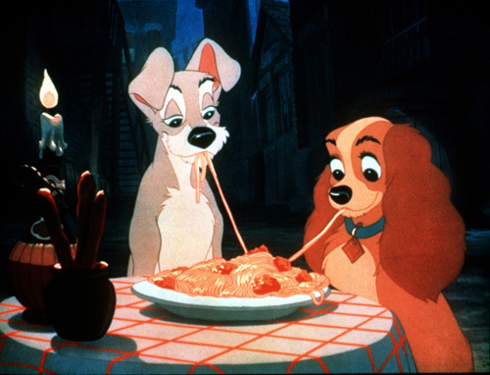
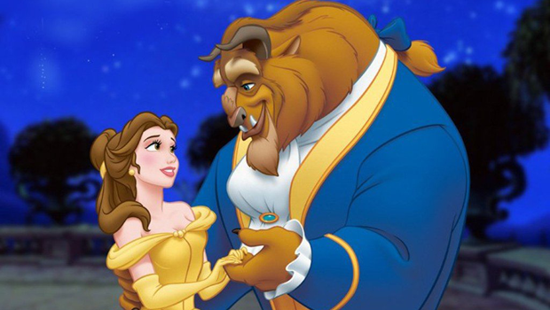

Slide 8
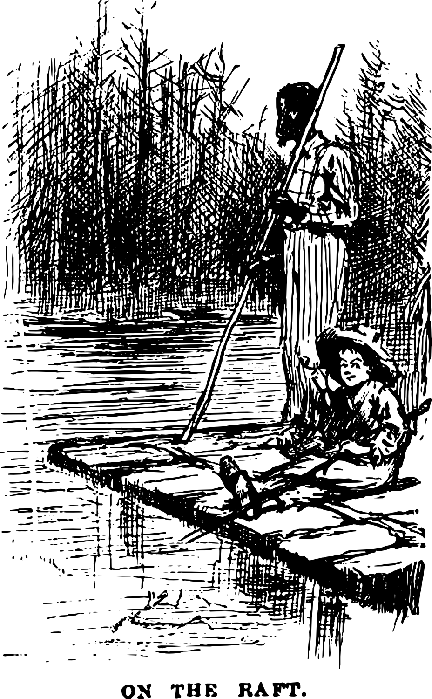
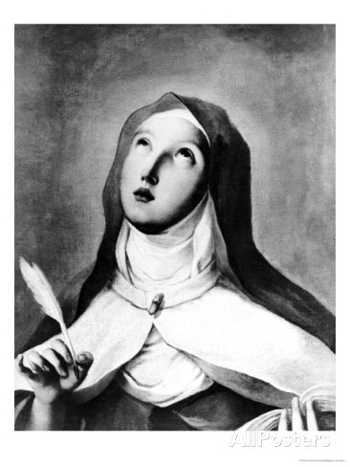
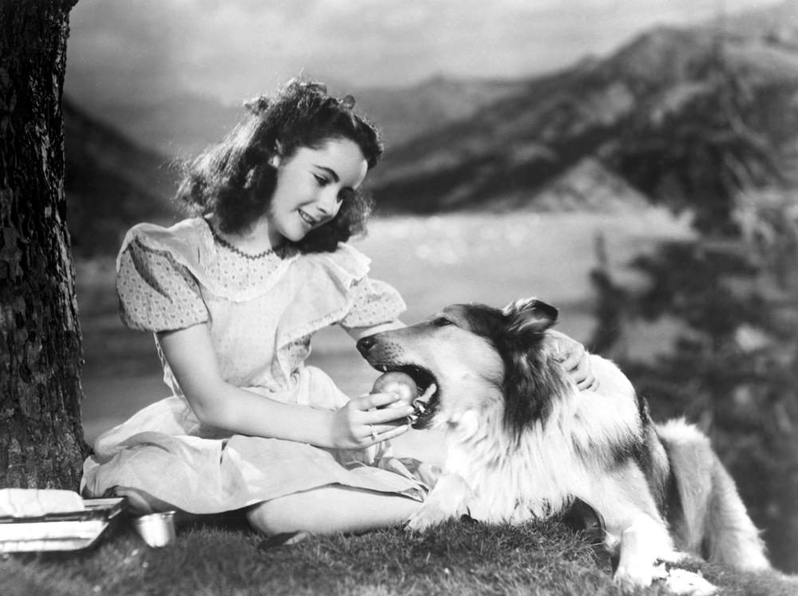

Slide 10
From Plato’s Symposium
Suppose, for example, that in order to secure money, or a public post…a man were willing to do what lovers do for the ones they love…his enemies would jeer at his fawning servility, while his friends, ashamed on his behalf, would try everything to bring him back to his senses…But let a lover act in any of these ways…and everyone will immediately say what a charming man he is!

Slide 11
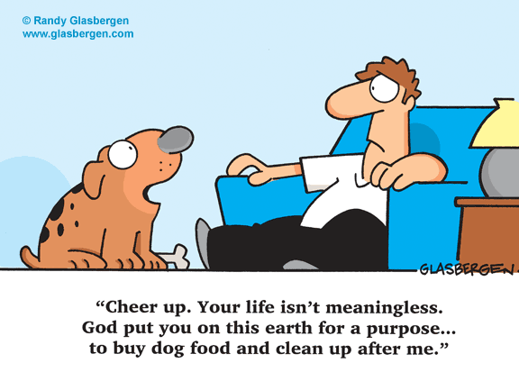
The Platitude
Love is
the most
robustly
meaning-
generating
psychological
condition

Slide 12
From Firestone’s The Dialectic of Sex
…“falling in love” is no more than the process of alteration of male vision—through idealization, mystification, glorification—that renders void the woman’s class inferiority…

Slide 13
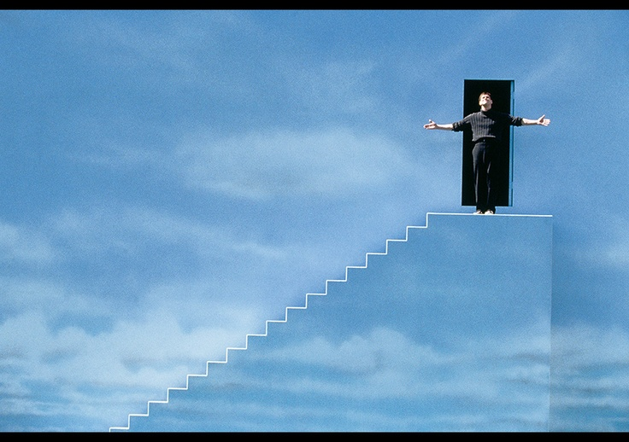

Slide 15
From Aristotle, Nicomachean Ethics
Just as, in the case of the virtues, some people are called good in their state of character, others good in their activity, the same is true of friendship. For some people find enjoyment in each other by living together, and provide each other with good things. Others, however, are asleep or separated by distance, and so are not active in these ways, but are in the state that would result in the friendly activities; for distance does not dissolve the friendship without qualification, but only its activity. But if the absence is long, it also seems to cause the friendship to be forgotten; hence the saying, ‘Lack of conversation has dissolved many a friendship’.

Slide 16
From St. Teresa of Avila
Now it seems to me that, when God has brought someone to a clear knowledge of the world, and of its nature, and of the fact that another world (or, let us say, another kingdom) exists, and that there is a great difference between the one and the other, the one being eternal and the other only a dream; and of what it is to love the Creator and what to love the creature…when one understands by sight and experience what can be gained by the one practice and lost by the other, and what the Creator is and what the creature, and many other things which the Lord teaches to those who are willing to devote themselves to being taught by Him in prayer, or whom His Majesty wishes to teach—then one loves very differently from those of us who have not advanced to that stage.

Slide 17
From Remembrance of Things Past
The idea of Time was of value to me for yet another reason: it was a spur, it told me that it was time to begin if I wished to attain to what I had sometimes perceived in the course of my life, in brief lightning-flashes…at those moments of perception which had made me think that life was worth living. How much more worth living did it appear to me now, now that I seemed to see that this life that we live in half-darkness can be illumined, this life that at every moment we distort can be restored to its true pristine shape, that a life, in short, can be realized within the confines of a book! How happy would he be, I thought, the man who had the power to write such a book! What a task awaited him!

Slide 18
From Murdoch, The Black Prince
We cannot really love the dead. We love a fantasm that secretly consoles.
All this may sound ridiculous. But being in love is a life-occupation. I suppose this concept resembles, or rather is a special case of, the idea of doing everything for God and making the whole of life into a sacrament…

