Slide 1
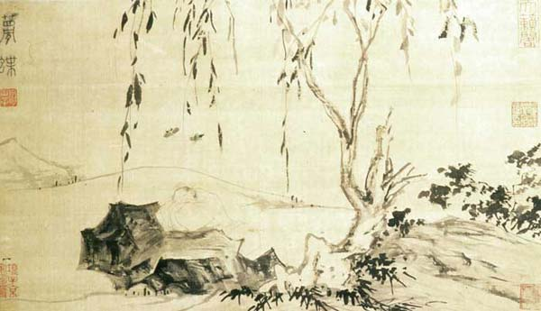
Lu Zhi Zhuangzi Dreaming of a Butterfly
(Ming dynasty, mid-16th century Ink on silk 29.4 x 51.4 cm)
Sceptical questions from Chinese philosophy: the Zhuangzi
A/Prof Karyn Lai
School of Humanities and Languages, UNSW

Slide 2
Warring States Period (472-221 BCE)
Confucius
551-479 BCE
The Analects
Lao Zi
6th? 4th? C BCE
Dao De Jing (Tao Te Ching)
Zhuang Zi
399?-299? BCE
https://en.wikipedia.org/wiki/Spring_and_Autumn_period#/media/File:Chinese_plain_5c._BC-en.svg

Slide 3
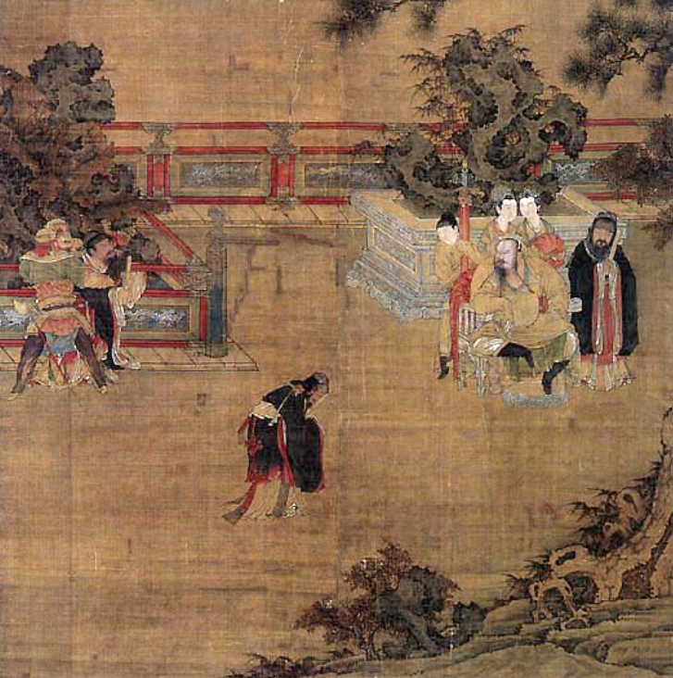
Official life: its discourse
“…daily there is the striving of mind with mind...There are small apprehensions which cause restless distress and great apprehensions that produce overwhelming fears.
There are those whose utterances are like arrows from a bow, who feel it their charge to pronounce what is right and what is wrong. There are those who, as if guided by a covenant, are determined to overcome.”
(Zhuangzi 2/3/27-8. Adapted from the translation by Legge 1962: 178-9).
“Breaking the Balustrade“ Anonymous, Sung Dynasty, National Palace Museum, Taiwan

Slide 4
Sceptical questions
‘Toothless’ asked Wang Ni, “Do you know what all things agree in calling right?”
“How would I know that?” said Wang Ni.
“Do you know that you don’t know it?”
“How would I know that?”
“Then do all beings know nothing?”
“How would I know that? …How can we know that when I say I know something, it is not actually ‘not-knowing’? Or how can we know that when I say I don’t know something, it is not actually ‘knowing’?”
(Zhuangzi 6/2/64-66; adapted from the translation by Watson 1968: 45)

Slide 5
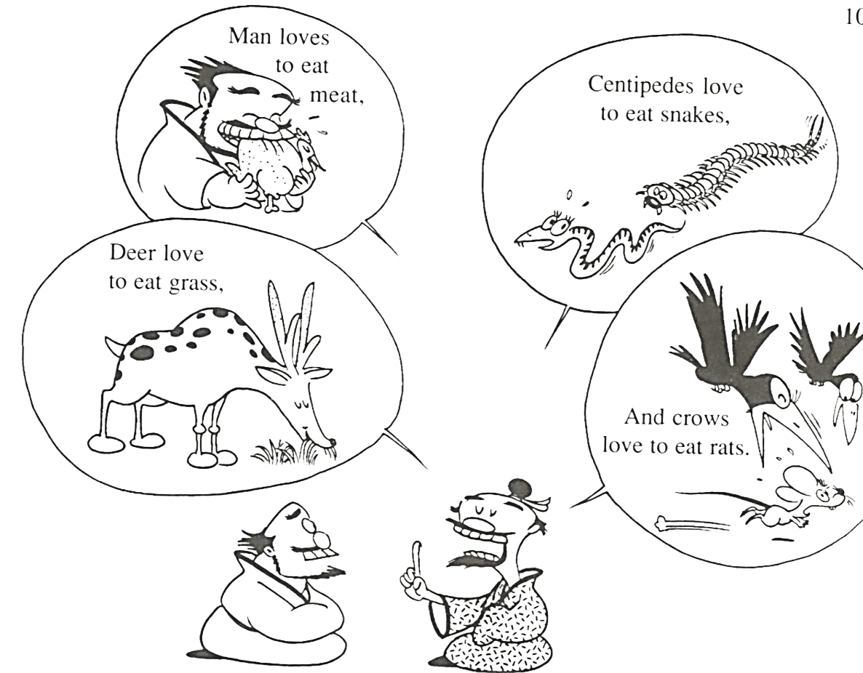
Sceptical questions
Of these four, which knows how to fix the standard of beauty for the world? The way I see it, the rules of benevolence and righteousness and the paths of right and wrong are all hopelessly snarled and jumbled. How could I know anything about such discriminations?
(6/2/66-70; trans. Watson 1968: 45-6).

Slide 6
Sceptical questions
‘Toothless’ asked Wang Ni, “Do you know what all things agree in calling right?”
“How would I know that?” said Wang Ni.
“Do you know that you don’t know it?”
“How would I know that?”
“Then do all beings know nothing?”
“How would I know that? …How can we know that when I say I know something, it is not actually ‘not-knowing’? Or how can we know that when I say I don’t know something, it is not actually ‘knowing’?”
(Zhuangzi 6/2/64-66; adapted from the translation by Watson 1968: 45)

Slide 7
What do we know?
The cicada and the little dove laugh at this, saying, “When we make an effort and fly up, we can get as far as the elm tree, but sometimes we don’t make it and just fall down on the ground. Now how is anyone going to go ninety thousand li to the south!”
(Zhuangzi 1/1/8-9; trans. Watson 1968, p. 30)

Slide 8
Insularity
There is nothing that is not “that” and there is nothing that is not “this.” Things do not know that they are the “that” of other things; they only know what they themselves know.
(Zhuangzi 4/2/27; adapted from the translation by Chan 1963, p. 182)

Slide 9
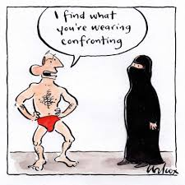
Indexicality
It is by establishing definitions of what is “this,” what is “right,” that boundaries are made…
There are right and left, then there are classes of things and ideas of the proper responses to them…
Wherever debate shows one of two alternatives to be right, something remains undistinguished and unshown.
(Zhuangzi 5/2/55-8; trans. Ziporyn 2009, p. 16)

Slide 10
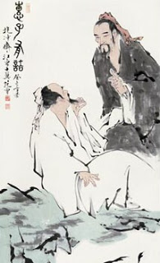
The wheelmaker and the Duke
Wheelmaker ‘Flat’: "May I ask what words are in the book Your Grace is reading?" "The classic of a famous sage," the Duke responded. "Is he still alive?" "Oh no, he is long dead." "Then you've been reading the dregs left over by a dead man, isn't it?"

Slide 11
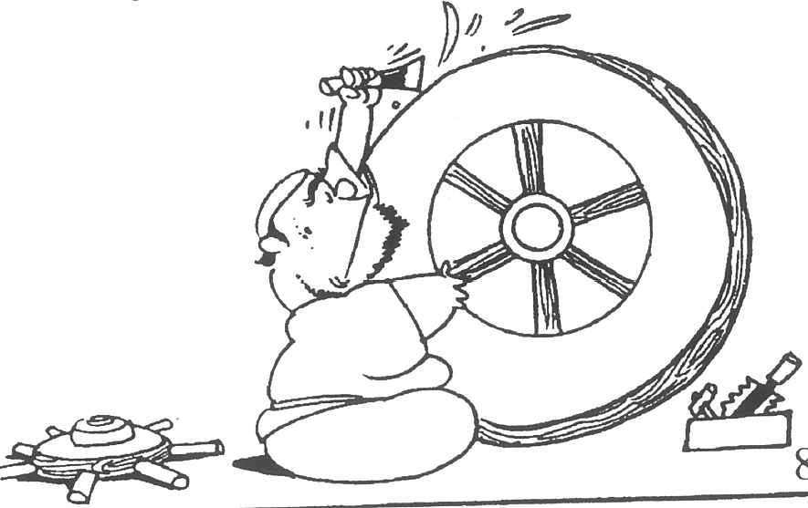
If the blows of the mallet are too gentle, the chisel slides and won't take hold. But if they're too hard, it bites in and won't budge. Not too gentle, not too hard - you can get it in your hand and feel it in your mind.
You can't put it into words, and yet there's a knack to it somehow.

Slide 12
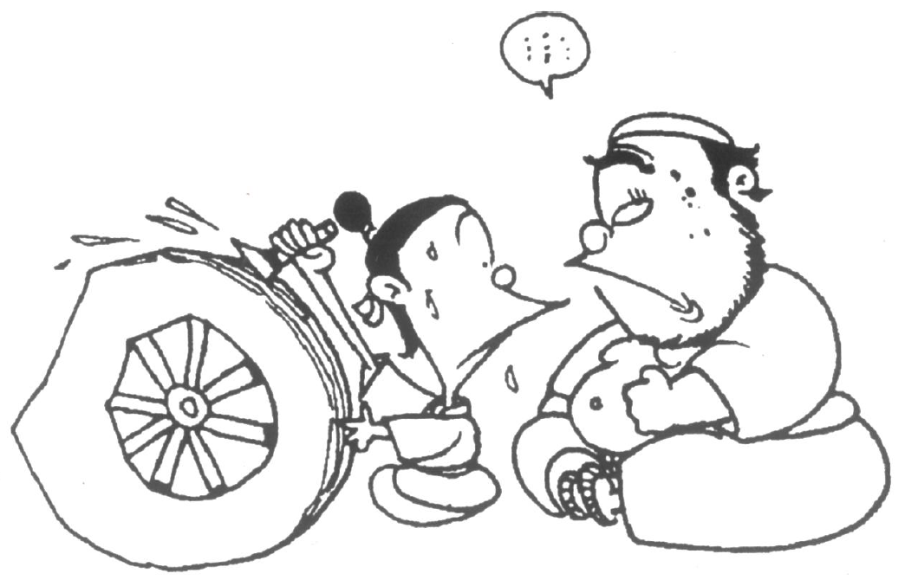
I can't teach it to my son, and he can't learn it from me. So I've gone along for seventy years and at my age I'm still chiseling wheels.

Slide 13
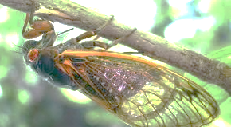
The hunchback cicada catcher
When Confucius was on his way to Chu, he passed through a forest where he saw a hunchback catching cicadas with a sticky pole as easily as though he were grabbing them with his hand…
“For the first five or six months I practise balancing two balls on top of each other on the end of the pole and, if they don’t fall off, I will lose very few cicadas. Then I balance three balls and, if they don’t fall off, I will lose only one cicada in ten. Then I balance five balls and, if they don’t fall off, I know it will be as easy as grabbing them with my hand.

Slide 14
The hunchback cicada catcher
When Confucius was on his way to Chu, he passed through a forest where he saw a hunchback catching cicadas with a sticky pole as easily as though he were grabbing them with his hand…
“For the first five or six months I practise balancing two balls on top of each other on the end of the pole and, if they don’t fall off, I will lose very few cicadas. Then I balance three balls and, if they don’t fall off, I will lose only one cicada in ten. Then I balance five balls and, if they don’t fall off, I know it will be as easy as grabbing them with my hand.
I position my body like a stiff tree trunk and hold my arm like an old dry limb. No matter how expansive heaven and earth are, or how numerous the ten thousand things, I’m aware of nothing but cicada wings…how can I help but succeed in taking them?’
(Zhuangzi 48/19/17-21. Adapted from the translation by Watson 1968: 199-200).

Slide 15
Zhuangzi’s questions
What do we know?
- Insularity
- The familiar, the safe and the habitual
The Zhuangzi’s epistemological paradigm
Responsiveness
Discipline and attunement
The physical and the mental

Slide 16
Mastery and life
The uncompleted life
Ideal action

